Slide 1
RR INSTITUTE OF TECHNOLOGY
NAME : BINDU.D
BRANCH : COMPUTER SCIENCE AND TECHNOLOGY
ETHNUS ID : ETHSFB4051
TEAM NAME : MITHALI RAJ
TOPIC : Strength

Slide 2

INTRODUCTION
What is SWOT Analysis?
SWOT Analysis is a strategic planning tool used to understand a situation, business, project, or even a person by examining four key factors:
S – Strengths
Internal qualities that give an advantage.
Example: Good leadership, strong brand, skilled employees.
W – Weaknesses
Internal factors that create disadvantages.
Example: Low budget, outdated technology, poor marketing.
O – Opportunities
External chances to improve or grow.
Example: Increasing market demand, new technology, fewer competitors.
T – Threats
External factors that may cause problems.
Example: New competitors, government policy changes, economic slowdown.

Slide 3
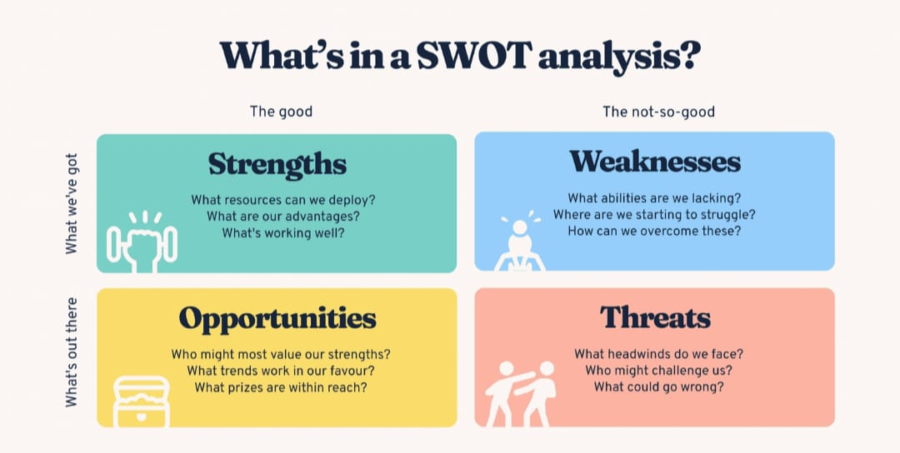
contents
Strengths
Strengths are the internal capabilities, assets, and advantages that help an organization perform well and stand out from competition.
characteristics of strengths:
- Completely internal
- Within the company’s control
- Contribute to performance, growth, and stability
why strengths matter:
- Build competitive advantage
- Increase customer loyalty
- Help capture larger market share
- Support long-term sustainability

Slide 4
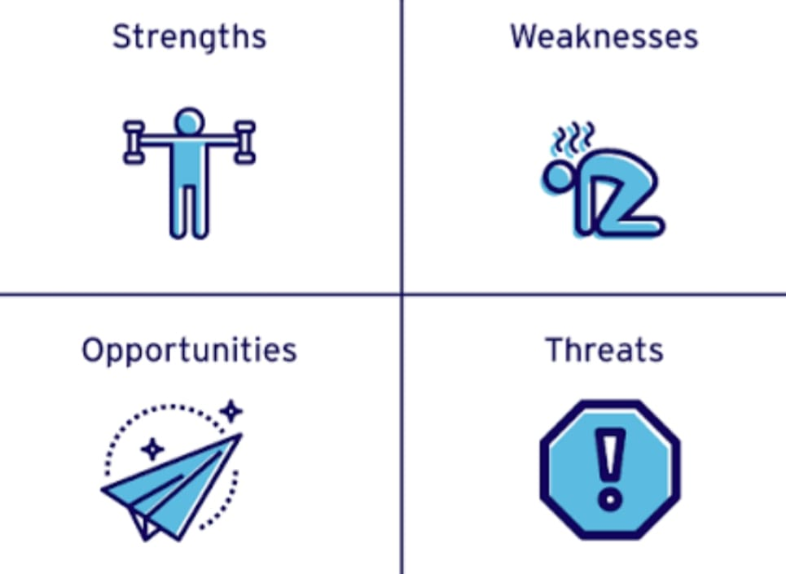
TYPES OF STRENGTHS
Strengths can come from different areas of the business.
1. HUMAN STRENGTHS:
* Skilled and experienced employees
* Strong leadership and management
* High employee motivation
2. FINANCIAL STRENGTHS:
* Strong cash flow
* Good profitability
* Ability to invest in growth
3. OPERATIONAL STRENGTHS:
* Efficient production or service delivery
* Advanced technology and tools
* Reliable supply chain
4. MARKET STRENGTHS:
* Strong brand image
* Customer loyalty
* Wide market presence

Slide 5

IMPORTANCE OF STRENGTHS IN SWOT ANALYSIS
Understanding strengths helps a business:
Build Competitive Advantage - Use strengths to stand out in the market.
Improve Strategy Planning - Focus resources on areas where the company performs best.
Achieve Long-Term Growth - Strengths allow expansion, innovation, and stability.
Increase Market Share - Strong capabilities help capture and retain customers.
Make Better Decisions - Managers can make informed choices by knowing what the business excels at.

Slide 6

How to Identify Strengths
Ask these questions:
- What do we do better than competitors?
- What do customers like most about us?
- What unique resources do we have?
- What skills make us successful?
- What internal advantages set us apart?
This helps identify the most powerful strengths.

Slide 7
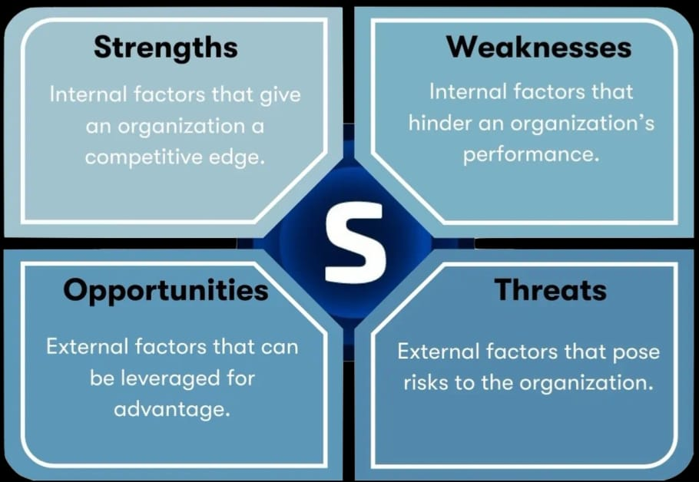
CONCLUSION
Understanding the strengths in a SWOT analysis helps a business clearly recognize what it does best and what advantages it has over competitors. By identifying these internal positive factors such as strong skills, good resources, a trusted brand, or high-quality products a company can build strategies that focus on its strongest areas. This allows the business to grow more effectively, compete confidently in the market, and use its strengths to achieve long-term success.

Slide 8
THANKYOU

